Slide 1
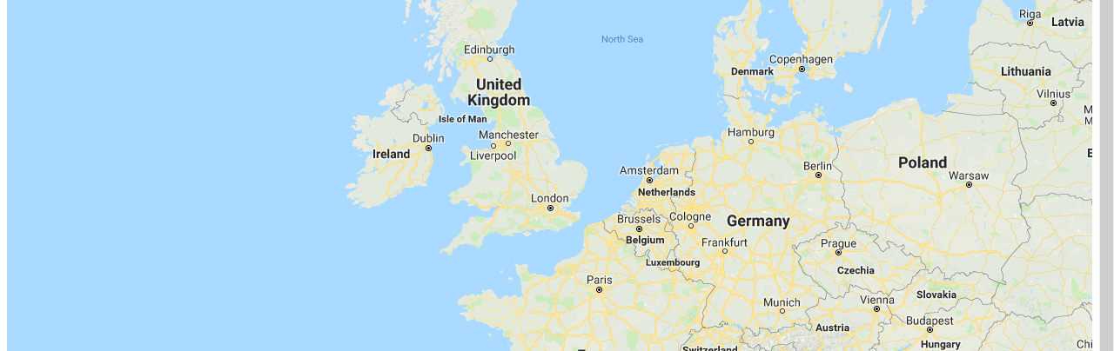
Using Google Maps in C# Applications
7th September 2018
Notes:
BuroHappold Base Corporate Presentation_Issue 004 2016

Slide 2
Architecture

Slide 3
Architecture
Google API
JavaScript
C# Forms
Maps
Routes
Distance Matrix
Interfaces Google to C#
Provides Windows interface, especially web browser

Slide 4
Getting API Key

Slide 5
Google API keys
Each access to Google API requires an API key, there are no more anonymous accessed
The API key is embedded in the JavaScript code
A standard license should have enough free queries so as to incur no charge
Website is https://developers.google.com/maps/documentation/javascript/get-api-key
The Google API developer console is https://console.developers.google.com/apis
<script src="https://maps.googleapis.com/maps/api/js?key=API_KEY&callback=myMap"></script>

Slide 6
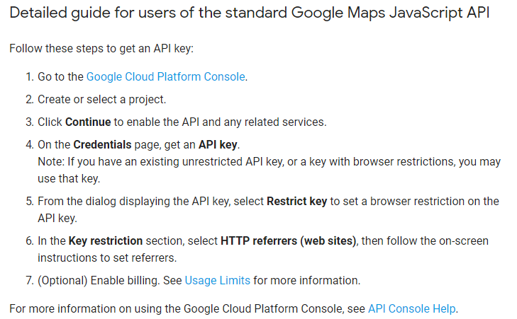
Procedure for getting an API KEY

Slide 7
Building the C# Interface

Slide 8
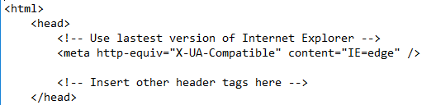
Web Browser Component
The web browser component loads the JavaScript code, and the JavaScript loads the Google Maps
Google Maps requires a modern version of a web browser
The Visual Studio web browser is a skin over Internet Explorer, but defaults to IE7 which is too old for Google Maps
The solution is to add the code in the JavaScript header to specify a modern browser

Slide 9
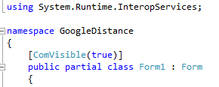
Enabling Communication
The C# code is going to use COM to communicate with JavaScript
Therefore, we have to make the code visible to COM
This is done with ‘ComVisible’ decoration, which we set to ‘true’

Slide 10

Web Browser Component
The web browser loads an HTML page by using the Navigate command
By setting ‘ObjectForScripting’ to ‘this’, it enables JavaScript calling code in C#

Slide 11

Calling JavaScript Code From C#
C# calls JavaScript from within the browser by using InvokeScript from within the Document of the web browser
The first argument in quotes is the name of the JavaScript function

Slide 12

Calling C# Code From JavaScript
Calling C# from JavaScript is even easier
The form in C# in JavaScript is known as ‘window.external’, due to setting ObjectForScripting
So, calling a function called ‘Test’ is then window.external.Test
Any parameters in the JavaScript call are passed as is to the C# method
JavaScript
C#

Slide 13
Manipulating Google Maps in JavaScript

Slide 14
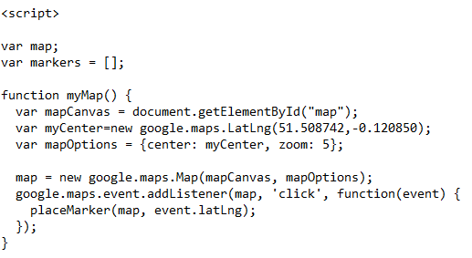
Creating Google Maps
The Google Maps API is accessed using <script src=
The API key is provided at this point
A callback is also provided, which actually creates a map and returns a variable pointing to the map (used later)
<script src="https://maps.googleapis.com/maps/api/js?key=API_KEY&callback=myMap"></script>

Slide 15
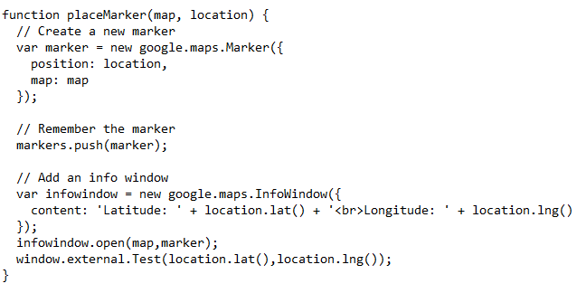
Creating Markers
When a marker is created it needs to be added to an array of markers, so that we know what is there, and so we can delete them again later
So, we declare ‘var markers=[]’, and empty list
Then we push each new marker onto the list

Slide 16
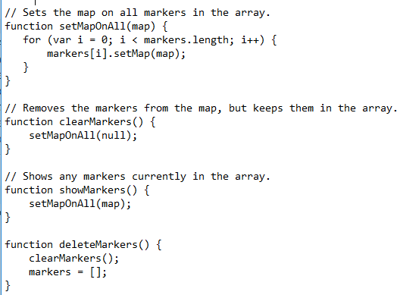
Deleting Markers
Each marker can have the map set for it
If the map is set to be null, the marker is hidden
Only if the markers array is set to an empty list are the markers actually deleted

